Slide 1
Unit IV: Equity in Health Care
Sanjay K Mohanty
Health Economics, 2024-25
Notes:
Central point is that by examining differences in health, or in access to health care, we cannot immediately draw conclusions about equity. Some inequalities may be considered justified while others are not. One approach to determining health equity is to ask whether health differences are the result of individual choices from equal opportunities. If yes, they may be considered equitable. If not, then some individuals are constrained to reach a lower level of health than others and this may be considered inequitable. If the difference in constraints derives from socioeconomic status, then the health inequality may be considered to represent social injustice. See references in chapter 1 of Analyzing Health Equity (AHE).
Note that in high-income countries with universal coverage, the poor do often make greater use of the health care. But this is largely, or wholly, due to their greater need, or lower health. Hence we cannot immediately infer from this health inequality that there is inequity. This is a good example of where the analysis of health equity must take a step beyond that of health inequality (see chapter 15).

Slide 2
Readings
Wagstaff, Adam & Paci, Pierella & van Doorslaer, Eddy, 1991. "On the measurement of inequalities in health," Social Science & Medicine, Elsevier, vol. 33(5), pages 545-557
Owen O’Donnell, Eddy van Doorslaer, Adam Wagstaff and Magnus Lindelow, "Analyzing Health Equity Using Household Survey Data” The World Bank, Washington DC, 2008, www.worldbank.org/analyzinghealthequity
Notes:
1.Additional references: Amartya Sen (1973) On Economic Inequality (Expanded Edition with a substantial annexe by James E. Foster 1997)

Slide 3
Outline: Basic Concepts
Understanding health, need and access
Defining health equity and inequality
Why Measure Health Equity
Vertical and horizontal equity
Methods of Measuring Health inequity
Notes:
What is meant by access to health care?
Is it different from receipt of health care?
What is meant by need?
Does equalising access means equalising health?

Slide 4
Context
Despite improvements in health status of the population, the gap in health between the most and least advantaged in society has been growing
Healthcare system can influence the extent to which the health inequity exist
Notes:
Average is improving but the differences between poor and rich are widening.
Like economic growth is taking place and poor becoming poorer and rich becoming richer
Egalitarian goals but Utilitarian tools
“Aam Aadmi” or “Inclusive Growth”
Health equity as an intrinsic objective
Egalitarian – we are worried about equity and distribution
Utilitarian – major concern is with maximisation of welfare, distribution is secondary and assessments can be misleading
How do we generally measure progress;
Averages
Proportions and Percentages
2. It is an ideal situation that

Slide 5
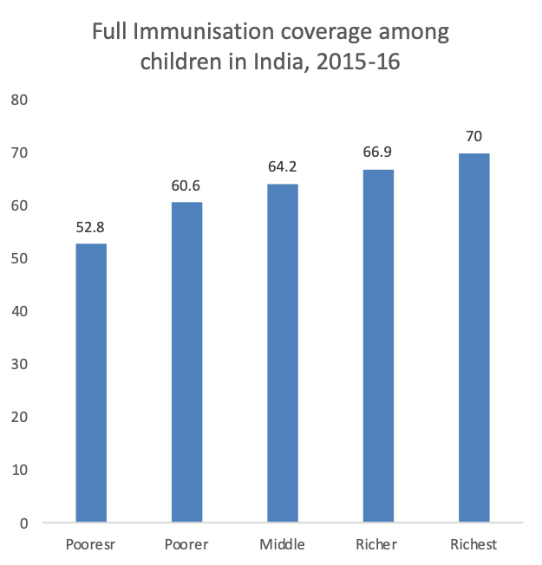
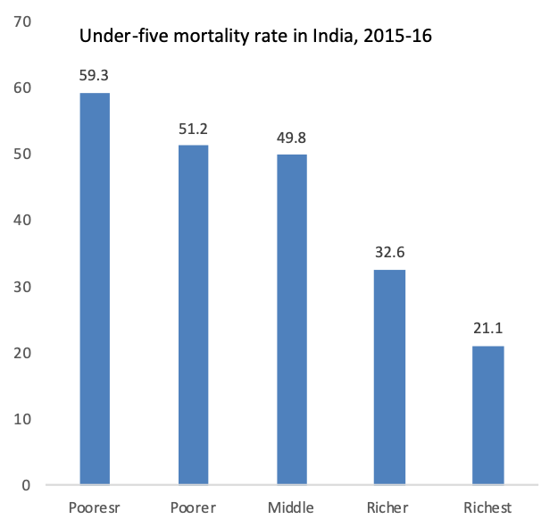
Under-five mortality rate and full immunization of Children in India, 2015-16
Source: IIPS and ORC Macro, NFHS 4, 2015-16

Slide 6
Context
Equity is recognized as an important policy objective in health care field
Equity in health care is a normative concept and inequality is positive
Notes:
Some suggest equity can take precedent over efficiency
Equity is concern to both policy makers and economist
Absence of any health inequality at all may well be an unattainable goal

Slide 7
Why measure health inequity?
Emphasis on “health of the deprived”
Shortcoming of mean-centric measures
Increasing focus on health inequity by international, national and donor agencies
Quantitative estimates of the magnitude, direction, and rate of change of health inequalities are critical for policymaking
Notes:
1. A wider interpretation of poverty
2. These interventions require; considerable information on varied dimensions of health inequalities
And comparisons are an integral part of monitoring and evaluation
3. Health care of the poor
4. Quantitative estimates are essential
The national average conceals large differentials across sub-groups and geographies

Slide 8
Health Inequalities & Health Inequities
  Health inequalities can be attributed to biological variations, free choice, the physical environment, and factors beyond the control of the individuals concerned.
  Health inequity is the ‘differences [in health status], which are unnecessary and avoidable, but in addition, are considered unfair and unjust’ (WHO 2000, Whitehead 1990)
Notes:
Inequity and inequality are two different concepts
Inequity is an ethical concept which reflects principles of social justice
Fair distribution of health or health equity
3.For example, differences in health care accessibility between socio-economic groups may be interpreted as an inequality as well as an inequity, while some differences in physical capabilities between elderly and younger people would not be considered an inequity as it is unavoidable.
3. Health inequalities can be measured quantitatively while health inequities cannot

Slide 9
Health Inequality ≠ Health Inequities
  Differences in physical capabilities between elderly and younger people in the population would be considered an inequality but not inequity
  Difference in health care accessibility between socio-economic groups may be interpreted as an inequality as well as an inequity
Notes:
Inequity and inequality are two different concepts
Inequity is an ethical concept which reflects principles of social justice
Fair distribution of health or health equity
3.For example, differences in health care accessibility between socio-economic groups may be interpreted as an inequality as well as an inequity, while some differences in physical capabilities between elderly and younger people would not be considered an inequity as it is unavoidable.
3. Health inequalities can be measured quantitatively while health inequities cannot

Slide 10
Equity of what?
Health outcomes: Infant mortality, under-five mortality, child growth, disability, incidence of illness, general health, life expectancy at birth
Health care utilisation: Outpatient visits, inpatient stays, vaccinations, maternity care.
Subsidies : received through use of public health care.
Payments for health care (both direct and indirect).
Notes:
The course covers analysis of inequality and inequity in respect of each of these four central variables of interest.
By direct payments we mean those paid out-of-pocket. Indirect payments would include health insurance premiums but also social insurance contributions and taxes that go toward the finance of public health care.

Slide 11
Horrizontal and Vertical Equity
    Horizontal equity – equal treatment of equals
    Vertically equity –unequal treatment of unequals
  In health care, most attention given to “equal treament for equal medical need irrespective of income, race, etc”
Notes:
Taxation in India- Verical equity. It is prigressive . Tax slab increases with increase in income

Slide 12
Horizontal Equity and Vertical Equity
Horizontal equity - whether, on average, persons in equal need of treatment receive similar treatment, regardless of their identity or income
Vertical equity, refers to whether persons in different degrees of need are treated in appropriately different ways
Notes:
If horizontal equity than people with equal health need will get service irrespective of income. If vertical equity than people with different degree of need are XX

Slide 13
Horizontal Vs Vertical
Horizontal inequality: Equal needs, but unequal care.
Rich Vs Poor for same disease
People with the same illness/need should get the same treatment, regardless of income, caste, or location
Vertical inequality: Unequal needs, but care not proportional to need
Patients with Cancer and mild hypertension have unequal need
People with greater health needs should receive more care/resources.
PMJAY addressed more of Horizontal inequality

Slide 14
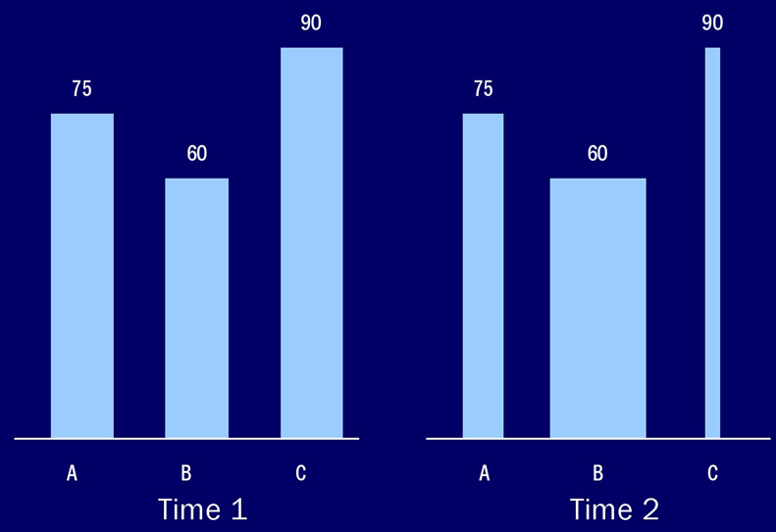
Average (T1) = Average (T2)?

Slide 15
Access
Access to treatment is opportunities open to people and receipt refers people availed the services
Access ≠ Treatment
Notes:
Equality of access: Treatment of an individual should depends on his medical conditions and symptoms and not his willingness and ability to pay
In policy and academic literature, access is defined as receipt of treatment
Access= Treatment

Slide 16
Need
Need is often equated with ill health
Need is defined as the minimum amount of resources required to exhaust the capacity to benefit.
Notes:
People who are ill are relatively in more need of health care (treatment); however those who are not ill can also receive care to improve their health in future (preventive)
If capacity to benefit is zero so is the need.
What about preventive treatment?

Slide 17
OUTLINE
A. Measuring socio-economic status
B. Measuring socio-economic inequality
C. Measuring health status
D. Measuring pure health inequality
E. Measuring socio-economic inequality in health
Notes:
Point 4 is also known as pure health inequality and point 5 is SES related inequality
1. In this chapter we will discuss the rank based measures. Ranking of individuals or households by means of living standard and evaluate the cumulative distribution of health across ranking
1.The main purpose of this chapter is to discuss the pure and SES related inequality in health.

Slide 18
A. Measuring socioeconomic status
Socioeconomic disparities in health
  1. Categorical indicator of socioeconomic status (SES): educational categories, occupation
  2. Continuous measure of living standards: Income, consumption, wealth
  Measures of inequality require ranking, preferably uniquely 1,….n
Notes:
Living standard is measured in multiple domain. For economic measures which variables would you like to use?

Slide 19
Measures of Economic Status
Flow variables
Income
  The amount that can be consumed in a given period without reducing the stock of wealth
Consumption
  The amount of resources actually used (consumed) during a given period
Stock variable
Wealth
  Total value of assets and liabilities at any point in time
  Wealth Index
Notes:
Flow variables represents quantities of resources that either come in to or go out of the household during a given period of time.
A stock is a quantity the household has at a given point in time.
Note that income is expressed in terms of potential consumption that could be realised without drawing on wealth. This is the Haig-Simons definition of income. This potential consumption is determined by the total, not only labour, earnings of the household, including transfers, plus the value of home production. Income is less accurate than consumption as a measure of long-term living standards since earnings may temporarily rise or fall during a period, but if a household consumes according to their life-time or permanent income, then consumption and living standards will not vary by as much.
Expenditure is the outlay on market traded goods and services. It is a less comprehensive measure of living standards than consumption and income since it does not cover consumption from household production. It is also a less accurate measure of long-term living standards since expenditures on durable items in any one period will temporarily raise expenditure but not living standards.
Consumption includes both market and home produced goods. Both because it covers home production and because, according to life-cycle theory, if varies with permanent income, it is considered the most preferred measure of living standards.
Wealth is a determinant of living standards but it does not reflect the consumption actually experienced.

Slide 20
Relationship between Measures of Living Standards
Income ≠ Consumption
  Tendency to smooth consumption over time and income may fluctuate
Consumption ≠ Expenditure
  Expenditure excludes non-market transactions
  Durables: use value may be different from expenditure
Notes:
In the absence of full private or social insurance against, for example, health risks, wealth may be held for precautionary motives. Then wealth may not be a good measure of living standards. Rather it may reflect differences in levels of insurance cover between households. The uninsured household may hold more wealth but does not enjoy a higher standard of living as a result.

Slide 21
B. Measures of Socioeconomic Inequality
Poverty Vs Inequality
Inequality measures can be calculated for any distribution, not just for consumption, income or other monetary variables, but also for health and other variables.
Notes:
Poverty measures then focus on the situation of those individuals or households at the bottom of the distribution.
Poverty measures depend on the average level of income or consumption in a country, and the distribution of income or consumption.
Inequality is a broader concept than poverty in that it is defined over the entire population, not only for the population below a certain poverty line.

Slide 22
B. Measures of Socioeconomic Inequality
  Percentiles; Deciles; Quintiles
  Mean; Standard deviation
  Variance, Covariance
  Coefficient of variation
Notes:
Measuring inequalities by SES involves dividing a population into appropriate socioeconomic groups; these groups can be individual measures of SES.
What is a (statistical) distribution?
Discrete and continuous income distribution
Socioeconomic status : Income, educational attainment, or occupation to classify populations1.
Income is generally considered the SES measure with the greatest impact on health inequalities.
Summary measures of inequality determine the degree to which these socioeconomic groups are related to health outcomes.
Therefore, before looking at summary measures it is important to examine the different methods of dividing a population into socioeconomic groups.

Slide 23
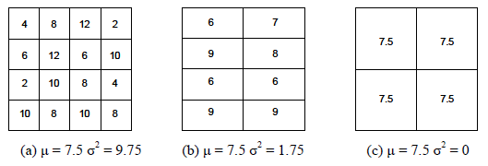
Same mean but varying Variance
Same mean
Notes:
Which one is more unequal?
Same mean but different variance. Hence more unequal

Slide 24
Commonly used Inequality Measures
1.Mean Log Deviation
2.Theil Index
3.Gini Index

Slide 25
MLD
The Mean Log Deviation (MLD) is a measure of inequality often used in economics and public health to quantify income or health disparities in a population.
It belongs to the family of generalized entropy measures, which can be sensitive to differences at the lower end of the distribution

Slide 26
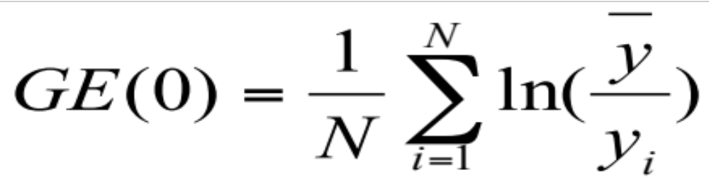
Mean Log Deviation
If y-=y, ln(y-/y)=ln(1)=0
Interpretation:
  MLD = 0: Perfect equality (all equal).
  Higher MLD implies greater inequality.
Sensitivity:
  MLD is more sensitive to changes at the lower end of the distribution (i.e., the poorest or least healthy).
Use in health:
  It can quantify inequalities in health outcomes, healthcare access, or income related to health.

Slide 27
MLD: Income
Person | Income yi(₹/month) | Mean Income yˉ | yˉ/yi | ln⁡(yˉ/yi
1 | 20,000 | 32,500 | 1.625 | 0.4855
2 | 25,000 | 32,500 | 1.3 | 0.2624
3 | 35,000 | 32,500 | 0.9286 | -0.0740
4 | 50,000 | 32,500 | 0.65 | -0.4308
Sum / N | – | – | – | 0.0608

Slide 28
MLD: IMR
Region | IMR (yi) | Mean IMR (yˉ) | yˉ/yi | ln⁡(yˉ/yi)
A | 30 | 45
B | 40 | 45
C | 50 | 45
D | 60 | 45
Sum / N | – | –
Low MLD indicates some inequality in IMR across regions; higher values indicate greater inequality

Slide 29
MLD: IMR
Region | IMR (yi) | Mean IMR (yˉ) | yˉ/yi | ln⁡(yˉ/yi)
A | 30 | 45 | 1.5 | 0.4055
B | 40 | 45 | 1.125 | 0.1178
C | 50 | 45 | 0.9 | -0.1054
D | 60 | 45 | 0.75 | -0.2877
Sum / N | – | – | – | 0.0326
Low MLD indicates some inequality in IMR across regions; higher values indicate greater inequality

Slide 30

THEIL INDEX
The Theil Index is a measure of inequality, often used for income, wealth, or health indicators.
It belongs to the Generalized Entropy (GE) family of inequality measures and corresponds to the case α = 1.
It measures the disparity of each individual’s value from the mean, giving more weight to larger values (e.g., higher income or higher mortality rates
T = (1 / N) × Σ [ (yᵢ / ȳ) × ln(yᵢ / ȳ) ]
N = number of units (e.g., regions, persons)
yᵢ = value for unit i (e.g., income, IMR)
ȳ = mean of all yᵢ
ln = natural logarithm
T=0, Perfect Equality
Higher the value of T, higher is the inequality

Slide 31
THEIL INDEX:EXAMPLE
Region | IMR (yᵢ) | yᵢ / ȳ | ln(yᵢ / ȳ) | (yᵢ / ȳ) × ln(yᵢ / ȳ)
A | 30 | 0.6667 | -0.4055 | -0.2703
B | 40 | 0.8889 | -0.1178 | -0.1047
C | 50 | 1.1111 | 0.1054 | 0.1171
D | 60 | 1.3333 | 0.2877 | 0.3836
Sum | – | – | – | 0.1256
ȳ=45
T = 0.1256 ÷ 4 = 0.0314

Slide 32
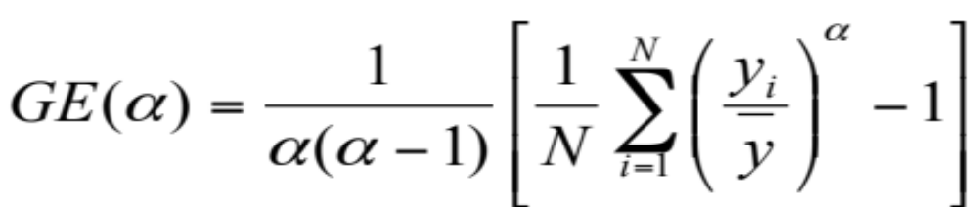
General Entropy Measures
Where α is the weight given to distance at different part of the income
GE=0, equal distribution
GE= ∞ , large inequality

Slide 33


The two generalized measure
A class of distribution sensitive measures
  Individual Mean Differences (IMD)
  Inter-Individual Differences (IID)

Slide 34
C. Measuring Health Status
Health outcomes
  Mortality: IMR, U5MR, MMR, LEB
  Morbidity, under-nutrition, obesity, diabetes, HIV
  Health care utilisation, Self rated, mental and physical health
  Early child development: Malnourishment, cognitive development

Slide 35
Three models of general health
Medical: Presence of (diagnosed) diseases, conditions, handicaps
Functional: Ability to perform “normal” tasks/roles.
  Impaired Activities of Daily Living (ADL), # days of restricted activity
Subjective: Individual’s perception of health
  Self Assessed Health (SAH)
  High predictive power for mortality and medical care utilisation
Notes:
. Health defined in terms of deviations from medical norms.
This lecture illustrates the use of the three different types of adult health indicators—medical, functional, and subjective—to describe the distribution of health in relation to socioeconomic status (SES).
A lot of research on SRH

Slide 36
Choice of health indicators
  Continuous
    life expectancy
    undernutrition (z-scores)
  Categorical
    Dichotomous (immunised or not)
    Ordinal (very poor, poor, good, very good, excellent)

Slide 37
Pure and SES health inequality
Pure health inequality
  When we measure inequality across individuals or groups by ranking them only on the basis of their health status
Socioeconomic rank related health inequality
  When we measure inequality in health across individuals or groups by ranking them by the selected socioeconomic variable
Notes:
1. Pure Inequalities: How far there is inequality in measurement of health or ill health across people irrespective of whether they happen to be on the socio-economic ladder
2. This approach does not capture whether person in poor health are rich or poor or professional
3. Interpretation of SES related health inequality develops consensus for social and political action
4. SES inequality in health: Pure inequalities does not capture whether person in poor health are rich or poor or professional
Pure inequalities approach does not consider the socio-economic dimension of health inequalities

Slide 38
Measures of Health Inequalities: Pure and socio-economic inequalities in health
1.Range
2. Lorenz curve and the Gini coefficient
3.Index of dissimilarity
4. Slope Index of Inequality/ Relative Index of inequality
5. Concentration curve and concentration Index
Notes:
1.Measuring inequalities in health is a first step in determining health inequities.
2.Once a population is determined to have an unequal distribution of health, the causes and context should be examined to determine whether these differences are inequitable and socially produced.
3. Some measures are based on entire distribution while others are based on part of the distribution. Identify which are part of the distribution and which are based on the full distribution
4. Relative and absolute??
This will cover the pure and SES related inequality. Because health is determined by large number of variables outside health system, SES variables are of great importance

Slide 39
Health Inequality and SES factors
The variation in health is largely determined by factors outside the health care system and related to social and economic status of individuals/households
Variation in health is systematically related to socio-economic inequality
Notes:
Egalitarian goals but Utilitarian tools
“Aam Aadmi” or “Inclusive Growth”
Health equity as an intrinsic objective
Egalitarian – we are worried about equity and distribution
Utilitarian – major concern is with maximisation of welfare, distribution is secondary and assessments can be misleading
How do we generally measure progress;
Averages
Proportions and Percentages
Considerable evidence indicates the variation in health in the burden of disease between groups of differing SES

Slide 40
D. Measures of Pure Health Inequality
The Range
2.The Lorenz Curve and Gini Coefficient
3.The Index of Dissimilarity
Notes:
Point 5 and 6 are SES related inequality
Some of these are pure and some of these are SES related (slope index and concentration index)

Slide 41
E. Measures of socio-economic inequality in health
4.The Slope Index of Inequality
5. Concentration curve and the Concentration Index
Notes:
Point 5 and 6 are SES related inequality
Some of these are pure and some of these are SES related (slope index and concentration index)
Measures of dispersion like the variance, coefficient of variation, or Theil’s index inform of total, not socioeconomic-related health inequality
Relative risk ratios, e.g. mortality in top to bottom occupation class, do not take account of group sizes
Rate ratios of top to bottom quintiles do not reflect the complete distribution
Rank-dependent measures—Lorenz curve and Gini Index—and their bivariate extensions—concentration curve and index—from income distribution literature and apply to socioeconomic-related inequality in health variables

Slide 42


1.Range
Range = Highest value-Lowest value
  Most frequently used measure of inequality
  Adult BMI in two regions
    Region A (16, 18, 18, 18, 25) BMI distribution
    Region B (16, 25, 25, 25, 25) BMI distribution
Interquartile range
Major concern: Distribution insensitive
What if the population of two regions is different?
Notes:
Region A (A1, A2, A3, A4, A5) (N= 5 Persons)
Region B (B1, B2, B3, B4, B5) (N= 5 Persons)
2. The gap between top and bottom group might remain unchanged but the extent of inequality between intermediate group might be increasing
Compares the rate of a health variable between the most advantaged group and the least advantaged group.
1.Absolute measure of inequality, difference in rates of the health outcome between the highest and lowest socioeconomic groups.

Slide 43
Range
Compares the rate of a health variable between the most advantaged group and the least advantaged group.
1.Absolute measure of inequality, difference in rates of the health outcome between the highest and lowest socioeconomic groups.
2. Relative measure of inequality: Divides the rate of the least advantaged group by the rate of the most advantaged group.
Notes:
When the AD is equal to zero, equality in health is said to exist.
A DRR of one represents the absence of inequality in the population.
For an adverse health event, a DRR greater than one represents an increase in ill health amongst the least advantaged.
The range can be an absolute measure of inequality, known as the absolute difference (AD), which takes the difference in rates of the health outcome between the highest and lowest socioeconomic groups.
The range can also be a relative measure of inequality, known as the disparity rate ratio (DRR) or the relative range.
The DRR can be interpreted as the relative disparity between the highest socioeconomic group and the lowest.

Slide 44
IMR by Wealth Quintile in India
Quintile | IMR per 1000 live births
Poorest Poorer Middle Richer Richest All | 70.4 68.5 58.3 44.0 29.2 57.0
Range=Q1-Q5=???
Q1/Q5=???
Notes:
70.4-29.2=41.2
41 point differences between top and bottom income group in IMR

Slide 45
Population Attributable Fraction (PAF)
R_{i} is the rate of health outcome in the non-reference group,
R₅ is the rate of the health outcome in the reference group (assuming five quintile),
P_{i} is the proportion of the population in the socioeconomic group
∑ Pi R_{i}
(------ - 1)
R₅
_____________________________
1+ ∑ Pi R_{i}
(------ - 1)
R₅
i ranges from 1 to 5
Notes:
1.PAF is calculated by summing the potential reduction in rates for each of the socioeconomic groups, accounting for the effect size of lower SES and the proportion of the population in each group
2.If PAF is significantly different from zero then an inequality is said to exist; a higher PAF is associated with greater inequalities

Slide 46
2.Lorenz Curve and Gini Index
Lorenz Curve and Gini Index are widely used measure of inequality
Lorenz curve is a graphical presentation on distributional inequality in income or wealth
It plot the cumulative proportions of the population (starting from the poorest) against the cumulative proportion of income or wealth
Notes:
First suggested by Max O’Lorenz in 1905
This measure can be used to represent any firm of inequality including health inequality

Slide 47
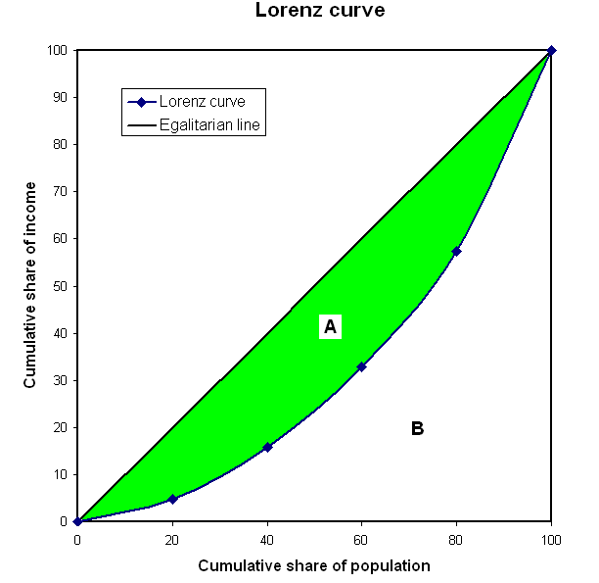
Lorenz Curve

Slide 48
Lorenz Curve: Health
Lorenz curve plot the cumulative proportions of the population (starting with the sickest person ending with the healthiest) against the cumulative proportion of health
Individuals are ranked by their health
Notes:
First suggested by Max O’Lorenz in 1905

Slide 49
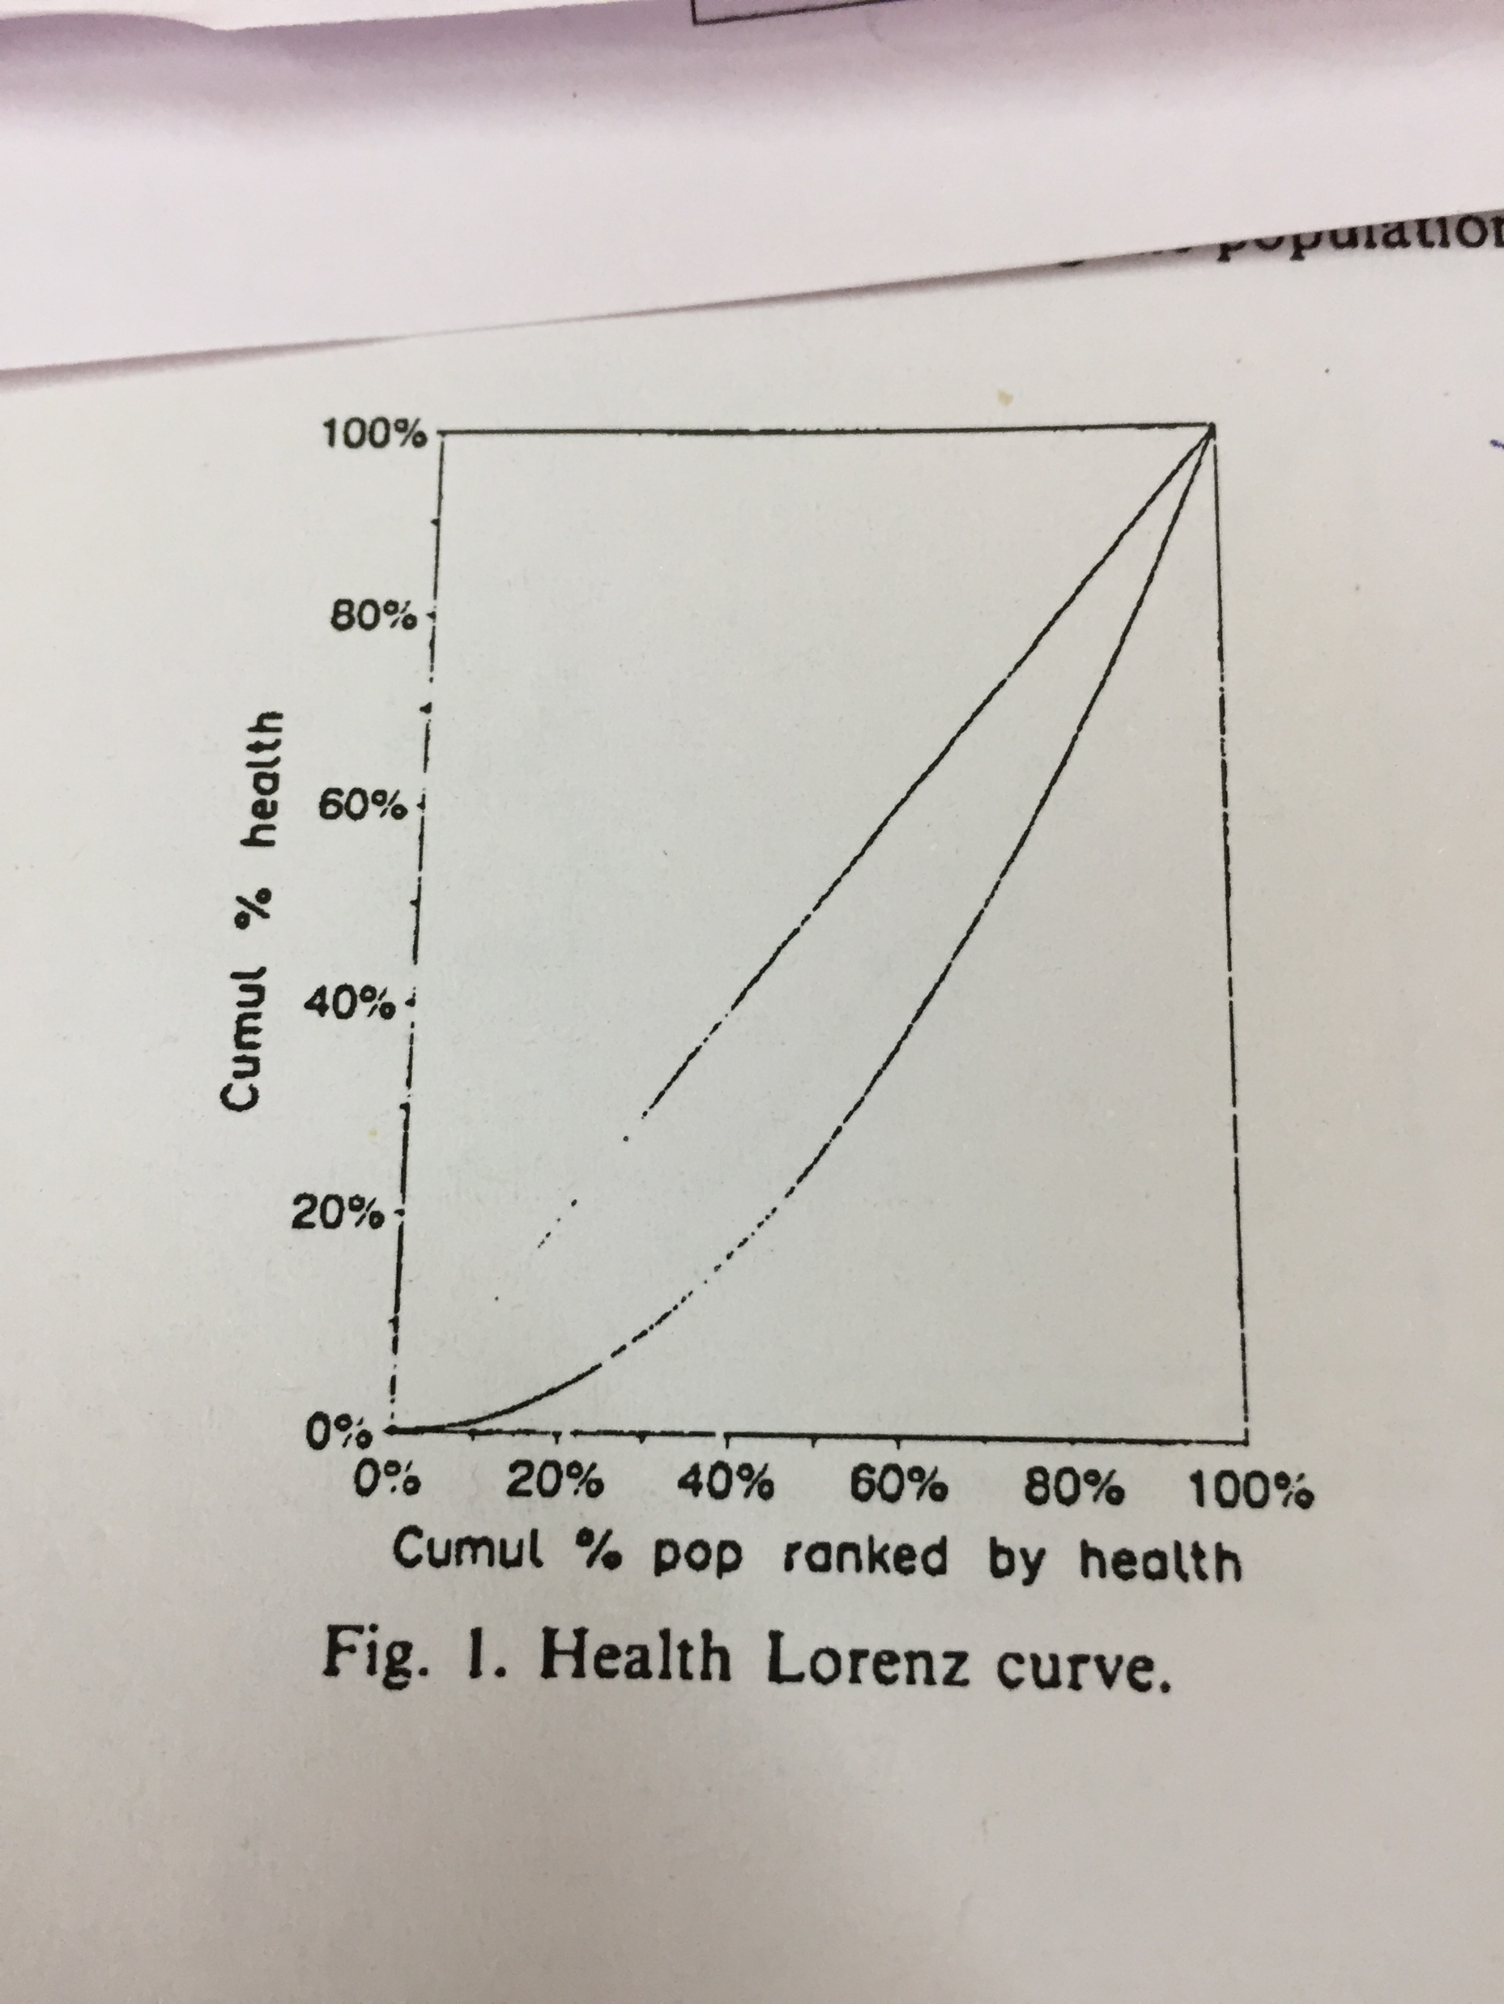
Lorenz Curve: Health
If health is equally distributed, the Lorenz curve coincide with the diagonal.
Otherwise it lies beneath the diagonal

Slide 50
Lorenz Curve and Gini Coefficient
The area between the Lorenz Curve and the diagonal line measures the extent of inequality and the measure is known as Gini coefficient
Gini coefficient is twice the area between the Lorenz curve and the diagonal line
Notes:
First suggested by Max O’Lorenz in 1905
Gini coeffcient=1 implies, the health is concentrated in one hand
Gini=0, perfect equality

Slide 51
Lorenz and Gini Coefficient of Ill health
G=0, if health is equally distributed
Lorenz curve coincides with the diagonal
G=1, the health is concentrated on one person
The laregr the gini coefficient, greater is the inequality
Notes:
First suggested by Max O’Lorenz in 1905
Gini varies between 0 and 1

Slide 52
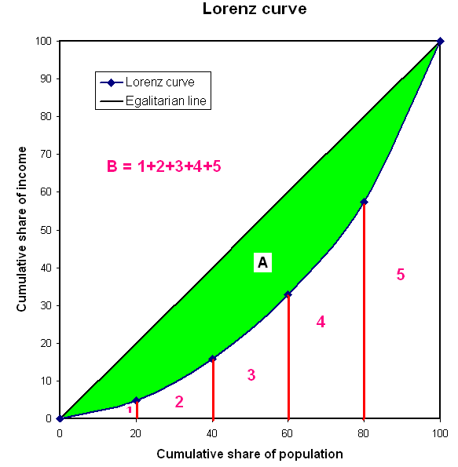
Gini Coefficient: Geometry
Area under line of equality has two part
Area A: Area between line of equality and Lorenz curve
Area B: Are Below the Lorenz curve
B=1+2+3+4+5
4.Gini Index= Area under line of equality and Lorenz curve (A)/ Area under line of equality (A+B)
5. Estimate B
6.A=0.5-B

Slide 53
Defining Gini Index
Gini Index is defined as A/(A+B)
=Area under the lorenz curve and line of equality/ Area under line of equality
Area A: Area between the line of perfect equality and Lorenz curve
Area B: Area under the Lorenz curve
Gini=A/A+B= A/0.5=2A
Given A+B=1/2, B=0.5-A
G=2A=2*(0.5-B)=1-2B
Gini is twice the area between the line of equality and lorenz curve or
Gini is one minus twice the area under the Lorenz curve
Notes:
If A is very small and close to 0, G=0.a+=0.5,1/2THE SAREA
If A is very large, B is small and so the coefficient is likely to be 1

Slide 54
Estimation of Gini Index
Estimation of Gini Index need understanding of Area under the Lorenz curve (B) and line of equality
Area under the Lorenz Curve can be estimated using Trapezium Rule

Slide 55
Gini Coefficient: An example
Income category | Group income | % share in Total income | N | % share in total N | Cumu. pop share | Cumu. income share
lowest 20% | 2350 | 4.7 | 200 | 20 | 20 | 4.7
2nd 20% | 5550 | 11.1 | 200 | 20 | 40 | 15.8
3rd 20% | 8550 | 17.1 | 200 | 20 | 60 | 32.9
4th 20% | 12200 | 24.4 | 200 | 20 | 80 | 57.3
top 20% | 21350 | 42.7 | 200 | 20 | 100 | 100
total | 50000 |  | 1000

Slide 56
Computing Gini Coefficient
  Area 1 = 20*4.7/2 = 47
  Area 2 = 20*(4.7+15.8)/2 = 205
  Area 3 = 20*(15.8 + 32.9)/2 = 487
  Area 4 = 20*(32.9 + 57.3)/2 = 902
  Area 5 = 20*(57.3+100)/2 = 1573
  Total Area B = 3214
  Area A = 5000 – 3214 = 1786
  Area A + Area B = 100*100/2 = 5000
  Gini = A/(A+B) = 1786/5000 = 0.36 or 36%

Slide 57
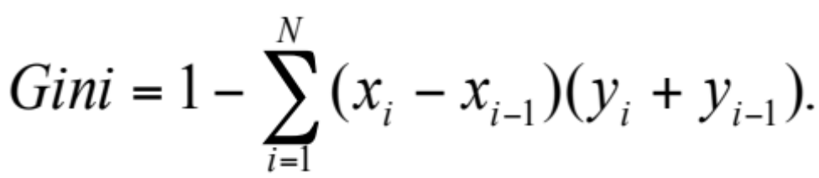
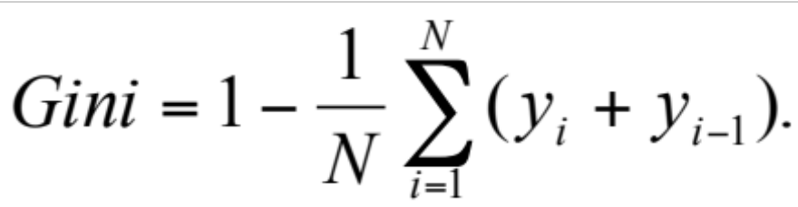
Gini Index
Let x_{i} be a point on the X-axis, and y_{i} a point on the Y-axis. Then
When there are N equal intervals on the X-axis this simplifies to

Slide 58
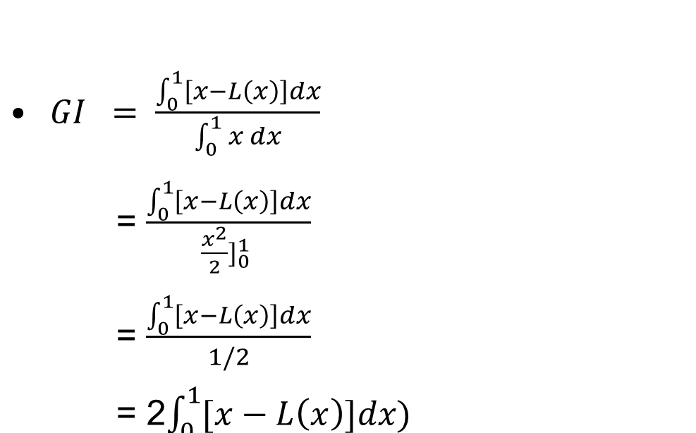
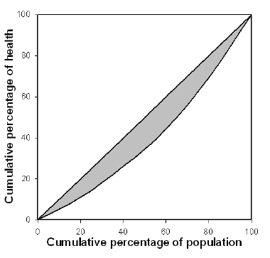

Gini Coefficient: Mathematical form
Cumulative percentage of Income/Health
y = x
Where L(x) is the percentage of total Income/ health of a Population cumulated by bottom x% of the population
Notes:
Gini Coefficient: A (0,0,0,1,1) and B (0,0,0,1,1) -- dichotomous
(Trick: Gini, in such case, = (1 – Mean of the distribution) = 0.6
Should we examine socioeconomic rank related inequality?

Slide 59

Gini Coefficient: Mathematical form
It can also be computed as
Notes:
Gini Coefficient: A (0,0,0,1,1) and B (0,0,0,1,1) -- dichotomous
(Trick: Gini, in such case, = (1 – Mean of the distribution) = 0.6
Should we examine socioeconomic rank related inequality?

Slide 60
Merits and Limitations of Gini Coefficient
Merits: It reflects experience of all person and not just in any social class
Limitations: It fails to capture the socio-economic inequalities in health
Notes:
To what extent these inequalities in health are systematically related to socio-economic status?

Slide 61
3. Index of Dissimilarity
Suppose there are j groups (j=1……n socioeconomic group)
The Index of dissimilarity is defined as (ID)
= ½ ∑|S_{jh} - S_{jp} |
Where Sjh=jth group’s share in health
S_{jp=} jth group’s population share
Higher the difference between Sjh and Sjp, the greater is the degree of inequality
Absolute value
If Sjh=Sip???
Limitation: Insensitive to the socio-economic dimension of inequality in health
Notes:
What matter in ID is how each socio-economic group share of the population health compares with the population share

Slide 62
4.Slope Index of Inequality (SII) and Relative Index of Inequality (RII)
SII and RII are regression based methods for determining the degree of inequality in a population.
SII involve calculating the mean health status of each socio-economic group and than ranking by their socio-economic status
Notes:
1.It can be defined as the absolute effect on health of moving from the lowest socio-economic group through the highest
2.It takes into account of entire distribution using appropriate regression model of the socioeconomic groups.
3.SII is considered an absolute measure of inequality
SII and RII reflect the socio-economic dimension of inequalities in health

Slide 63
Example: Slope index of inequality
Table 1 Midpoint values of cumulative range based on education subgroups, for a population of men and associated smoking prevalence
Education level | Proportional distribution of population | Cumulative range of population | Midpoint of cumulative range of population (x axis) | Smoking prevalence (%) (y axis)
No formal schooling | 0.0610 | 0–0.0610 | 0.0305 | 40.0
Less than primary school | 0.0856 | 0.0610–0.1466 | 0.1038 | 36.7
Primary school completed | 0.1980 | 0.1466–0.3446 | 0.2456 | 37.8
Secondary/high school completed | 0.5287 | 0.3446–0.8734 | 0.6090 | 33.4
College completed or above | 0.1266 | 0.8734–1.0000 | 0.9367 | 21.8
Source: Data derived from Hosseinpoor AR et al. Socioeconomic inequalities in risk factors for noncommunicable diseases in low-income and middle-income countries: results from the World Health Survey. BMC Public Health, 2012, 12:912.
Notes:
The question was asked why not directly regress prooprtion distribution of population against smoking. Why cumulate and take mid?
It is a valid question
To illustrate how the slope index of inequality is calculated, Table 1 breaks down the proportional distribution of the population, cumulative range of the population and midpoint of the cumulative range of population values for education subgroups among men living in 27 middle-income study countries.
The smoking prevalence in each education level is shown alongside.
These columns represent the x axis (midpoint of cumulative range) and y axis (smoking prevalence) in the next figure...

Slide 64
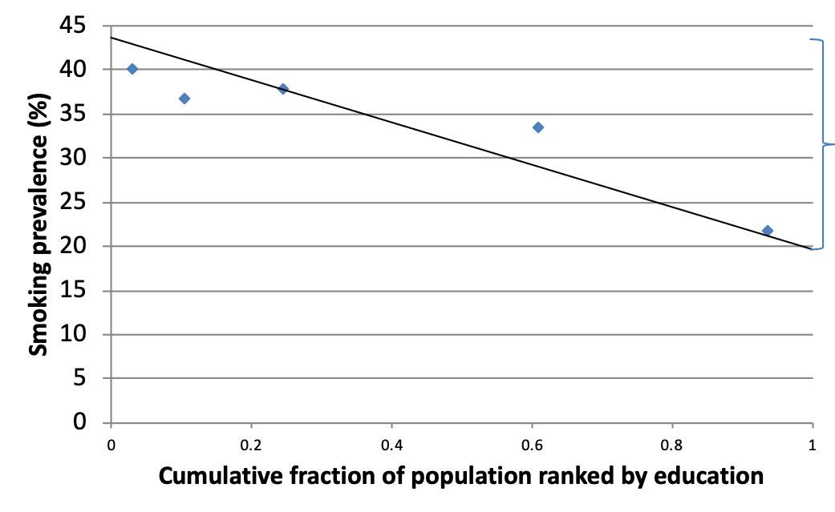
Example: Slope index of inequality
Figure 1 Slope index of inequality: absolute inequality in smoking prevalence among men
Slope index of inequality
= 19.6 – 43.6
= –24.0 percentage points
Source: Data derived from Hosseinpoor AR et al. Socioeconomic inequalities in risk factors for noncommunicable diseases in low-income and middle-income countries: results from the World Health Survey. BMC Public Health, 2012, 12:912.
Notes:
Building on the information in Table 1 on the previous slide, the prevalence of smoking within each education subgroup is regressed against the midpoint of cumulative range (Figure 1). This provides the predicted values of smoking prevalence among the individuals with the lowest and the highest education level (43.6% at rank 0 and 19.6% at rank 1).
The slope index of inequality – or the difference between these two values – is calculated to be –24.0 percentage points (19.6 minus 43.6), demonstrating absolute, education-based inequality in smoking among men living in middle-income study countries.
The negative sign indicates that smoking is more prevalent among the least educated.

Slide 65
Slope index of inequality
To calculate the slope index of inequality:
  A weighted sample of the whole population is ranked from the most disadvantaged subgroup (at rank 0) to the most advantaged (at rank 1) according to, for example, education or wealth
  The population of each wealth or education category is considered in terms of its range in the cumulative population distribution, and the midpoint of this range
  The health indicator of interest is regressed against this midpoint value for wealth or education subgroups using an appropriate model
  The predicted values of the health indicator are calculated for the two extremes (rank 1 and rank 0)
  The difference between the predicted values at rank 1 and rank 0 (covering the entire distribution) generates the slope index of inequality value
Notes:
When the slope of the regression line is flat, the slope index of inequality is 0.
When ranking from the most disadvantaged to the most advantaged, positive values indicate that the health indicator of interest is more prevalent in the most advantaged subgroup, whereas negative values mean that the indicator is more prevalent in the most disadvantaged subgroup.
The slope index of inequality value has straightforward meaning and has the same unit of measure as the health indicator, making it very useful.
Non-technical audiences can understand the slope index as an estimate of the difference in a given health indicator between the worst-off and best-off individual in a population, though they may initially understand little about how the number is calculated or why it provides an advantage over simple difference.

Slide 66
SII: An example
Y = 16 + 1.3X; where, Y represents BMI and X represents annual income in $1000
For each additional one thousand dollar of income the BMI increases by 1.3Kg/m²
X should be measured in interval scale and not in ordinal scale, like social class
Problems:
  In case of grouped data – heteroscedasticity
  SII sensitive to mean health status

Slide 67
SII and RII
Large negative values of the SII indicate high levels of inequality with higher rates among the least advantaged.
One limitation of using the SII and RII is that the SES variable must be measured on an interval scale

Slide 68
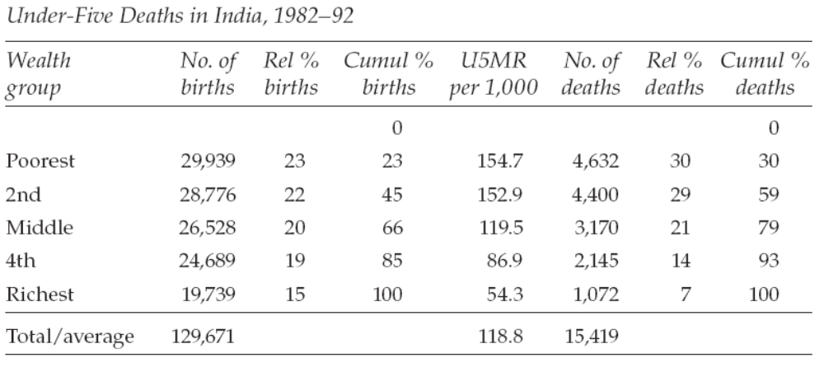
5. Toward concentration curve

Slide 69
Concentration curve
People are ranked not by their health but by socio-economic status , beginning with most disadvantageous
It plots the cumulative proportion of the population (beginning with the most disadvantageous to least disadvantageous ) against the cumulative proportion of health.
Notes:
It forms the diagonal representing line of equality
If CC lies above the diagonal ill-health is concentrated among poorer individuals
Testing for dominance

Slide 70
Concentration curve
Concentration curve plots the
  Cum. proportion of population ranked in terms of income/wealth on x-axis
  Cumulative proportion of ill-health on y-axis
Ideal: ill-health cumulates proportionally matching with the cumulative share of the population
Notes:
It forms the diagonal representing line of equality
If CC lies above the diagonal ill-health is concentrated among poorer individuals
Testing for dominance

Slide 71
Concentration Index
Concentration curve does not give a measure of the magnitude of inequality
Concentration index quantify the degree of socio-economic inequality in a health variable (Kakawani, Wagstaff and vanDoorslaer 1997)
Notes:
CC is bivariate extension of lorenz curve, Lorenz curve does not take into account two variables. Only one variable. Here ill health is ranked by economic status

Slide 72
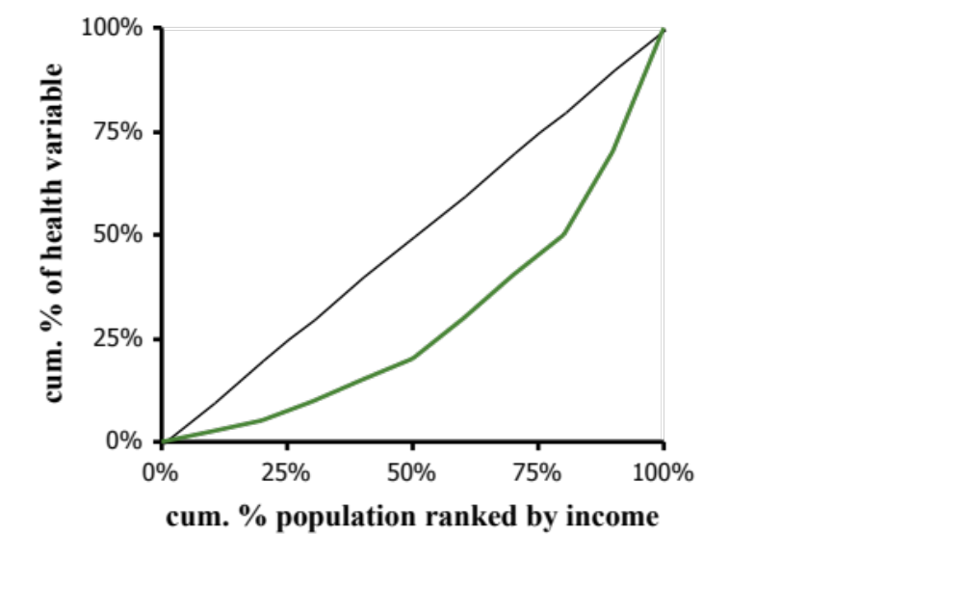

Concentration index defined
C = 2 x area
between 45⁰ line and concentration curve
= A/(A+B)
C>0 (<0) if health variable is disproportionately concentrated on rich (poor)
C=0 if distribution in proportionate (no inequality)
C lies in range (-1,1)
C=1 if richest person has all of the health variable
C=-1 of poorest person has all of the health variable
A
B
Notes:
7
The positive/negative sign for pro-poor/pro-poor distribution is simply convention.
Note that although a proportionate distribution i.e. the concentration curve lying on top of the 45o line is sufficient for the index to take a value of zero, it is not necessary. The concentration curve could cross the 45o line and give a concentration index of zero. Hence it is always advisable to examine both the concentration curve and the index.

Slide 73
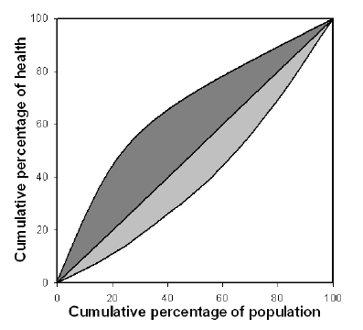
Concentration Index
The Concentration Index (CI) could be derived from the CC and is defined as twice the area between the CC and the diagonal.
Notes:
But a concentration curve does not give a measure of the magnitude of inequality that can be compared conveniently across many time periods, countries, regions, or whatever may be chosen for comparison. The concentration index (Kakwani 1977, 1980), which is directly related to the concentration curve, does quantify the degree of socioeconomic-related inequality in a health variable (Kakwani, Wagstaff, and van Doorslaer 1997; Wagstaff, van Doorslaer, and Paci 1989). It has been used, for example, to measure and to compare the degree of socioeconomic-related inequality in child mortality (Wagstaff 2000), child immunization (Gwatkin et al. 2003), child malnutrition (Wagstaff, van Doorslaer, and Watanabe 2003), adult health (van Doorslaer et al. 1997), health subsidies (O’Donnell et al. forthcoming), and health care utilization (van Doorslaer et al. 2006). Many other applications are possible.

Slide 74
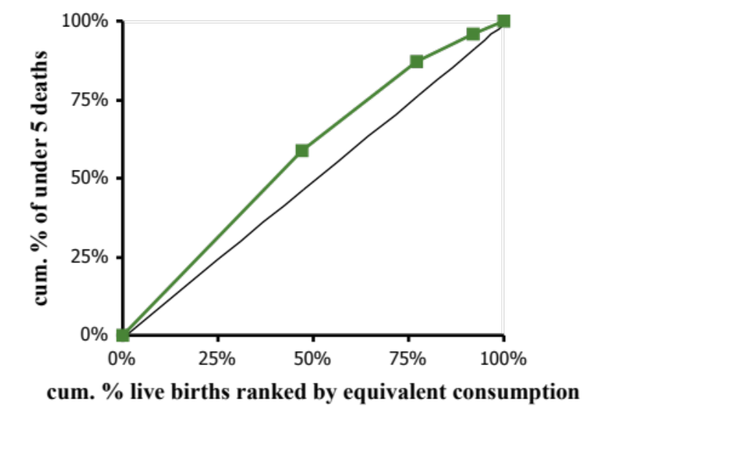
Concentration index (CI)
CI = 2 x area
between 45⁰ line and
concentration curve
CI < 0 when variable
is higher amongst poor
Notes:
7
The concentration index provides a summary measure of the magnitude of socioeconomic-related inequality in a health variable of interest.
Comparing a set of numbers can give a clearer ranking when trying to compare inequality across a number of countries, regions or time periods. But must acknowledge that the index loses information relative to the concentration curve. It summarises the distribution in one number of so does not indicate at what points in the distribution there are departures from proportionality. The concentration index should be used in tandem with the concentration curve.

Slide 75
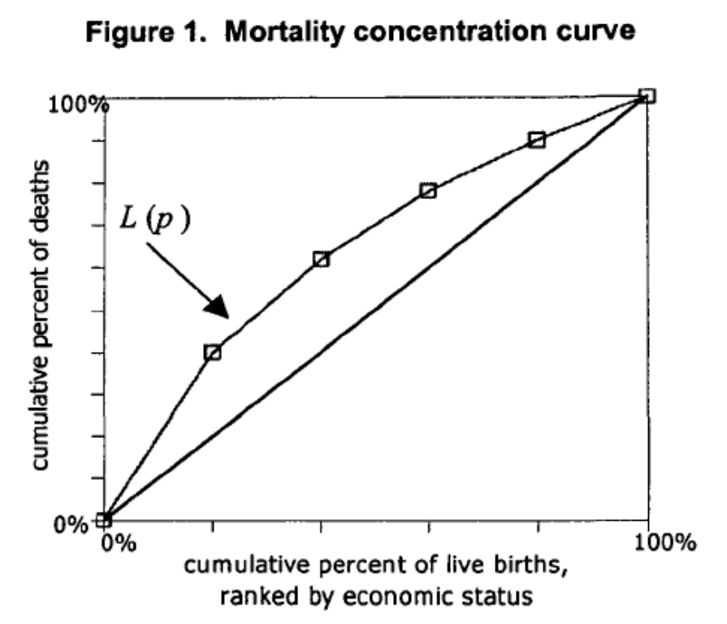
Concentration curve
Curve above the diagonal →
Concentration of poor health among the poor
Curve below the diagonal →
concentration of poor health among the rich
Curve on the diagonal = equality
Which variables may have these
shape???.
Living standards variable only
needs to provide a ranking.
Notes:
CC is bivariate extension of lorenz curve, Lorenz curve does not take into account two variables. Only one variable. Here ill health is ranked by economic status

Slide 76
Lorenz Curve and Concentration Curve
Lorenz Curve
Concentration curve
Concentration curve is a widely measure of health inequality
It is a graphical presentation of cumulative % of health variable against the cumulative % of population ranked by income/socio-economic status
It usages two variables; health and income
In deriving concentration curve, we arrange the health data by rank of income
We plot the cumulative % of health variable against the cumulative % of income
The diagonal line is the line of perfect equality
Concentration curve can be above the diagonal line/ below the diagonal line
Lorenz curve is a widely measure of income inequality.
It is a graphical presentation of cumulative % of population (starting from poorest) against cumulative % of income/wealth
It uses only one variable, distribution of population by income/wealth
In deriving Lorenz curve, we arrange the income data in ascending order and than cumulate the distribution
We plot the cumulative % of population against the cumulative % of income
The diagonal line is the line of perfect equality where inequality is 0

